Slide 1


UNDERSTANDING THE DIFFERENCE BETWEEN A ROUTER AND A SWITCH
Presented By : Md. Alomgir Hossain
SUST

Slide 2
INTRODUCTION
1
Key Network Devices: Router vs. Switch
Router: Connects different networks and directs data between them
2
Switch: Connects devices within a single network, enabling communication between them.
3
Why the Difference Matters: Understanding their roles helps in designing and troubleshooting network setups
5

Slide 3
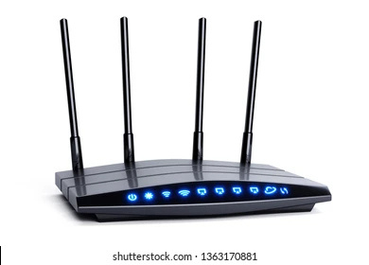
WHAT IS A ROUTER?
Router Overview:
Function: Directs data packets between different networks (Layer 3 - Network Layer).
Primary Role: Routes traffic based on IP addresses.
Key Features:
Routes between different IP networks (e.g., LAN to WAN).
Assigns IP addresses using DHCP.
Supports advanced features like NAT, VPN, and firewall security.
Example: Internet router connecting a home network to the internet.
12

Slide 4

WHAT IS SWITCH
Switch Overview:
Function: Connects devices within the same network and forwards data using MAC addresses (Layer 2 - Data Link Layer).
Primary Role: Facilitates communication within a Local Area Network (LAN).
Key Features:
Operates within a single network (LAN).
Uses MAC addresses for data forwarding.
Supports VLANs for network segmentation.
Example: Network switch connecting computers, printers, and servers within an office.
3

Slide 5
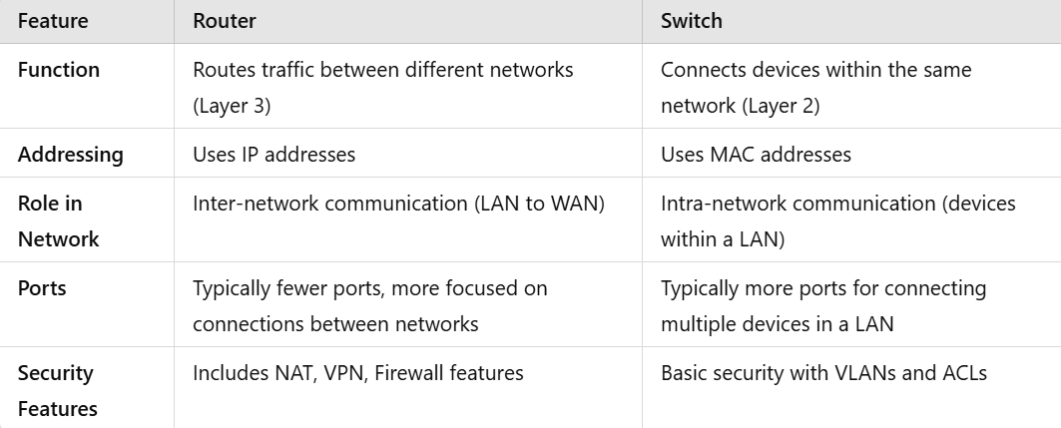
ROUTER VS. SWITCH: KEY DIFFERENCES
FeatureRouterSwitch
Function
Routes traffic between different networks (Layer 3)
Connects devices within the same network (Layer 2)
Addressing
Ues IPddresses
Uses MAC addresses
Role in Network
Inter-network communication (LAN to WAN)
Intra-network communication (devices within a LAN)
Ports
Typically fewer ports, more focused on connections between networks
Typically more ports for connecting multiple devices in a LAN
Security Features
Includes NAT, VPN, Firewall features
Basic security with VLANs and ACLs
8

Slide 6

THANK YOU

